Slide 1
C++
Md. Abdur Rahman
Senior Computer Scientist
Centre for Advanced in Research in Sciences (CARS)
University of Dhaka

Slide 2
Multidimensional Array
The multidimensional array is also known as rectangular arrays in C++
The data is stored in tabular form (row ∗ column) which is also known as matrix.
Total number of elements that can be stored in a multidimensional array can be calculated by multiplying the size of all the dimensions.
int x[10][20] can store total (10*20) = 200 elements.
int x[5][10][20] can store total (5*10*20) = 1000 elements.

Slide 3
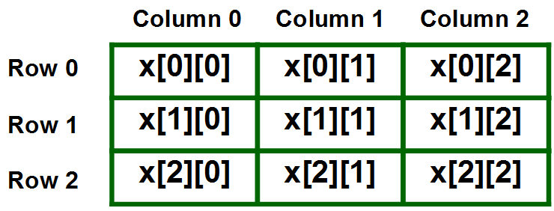
Two Dimensional Array
int x[3][3];

Slide 4
Two Dimensional Array
Initializing Two – Dimensional Arrays:
First Method:
int x[3][4] = {0, 1 ,2 ,3 ,4 , 5 , 6 , 7 , 8 , 9 , 10 , 11}
Better Method:
int x[3][4] = {{0,1,2,3}, {4,5,6,7}, {8,9,10,11}};

Slide 5
Two Dimensional Array
#include<iostream>
using namespace std;
int main()
{
int test[3][3]; //declaration of 2D array
test[0][0]=5; //initialization
test[0][1]=10;
test[1][1]=15;
test[1][2]=20;
test[2][0]=30;
test[2][2]=10;
//traversal
for(int i = 0; i < 3; ++i)
{
for(int j = 0; j < 3; ++j)
{
cout<< test[i][j]<<" ";
}
cout<<"\n"; //new line at each row
}
return 0;
}

Slide 6
Two Dimensional Array
#include<iostream>
using namespace std;
int main()
{
// an array with 3 rows and 2 columns.
int x[3][2] = {{0,1}, {2,3}, {4,5}};
// output each array element's value
for (int i = 0; i < 3; i++)
{
for (int j = 0; j < 2; j++)
{
cout << "Element at x[" << i
<< "][" << j << "]: ";
cout << x[i][j]<<endl;
}
}
return 0;
}

Slide 7
Two Dimensional Array
#include<iostream>
using namespace std;
int main()
{
int marr[3][3] =
{
{2, 5, 5}, {4, 0, 3}, {9, 1, 8}
};
for(int i=0; i< 3; i++)
{
for(int j=0; j<3; j++)
{
cout<<marr[i][j]<<"";
}
cout<<"\n"; // new line at each row
}
return 0;
}

Slide 8
Three Dimensional Array
Initialization in Three-Dimensional array is same as that of Two-dimensional arrays.
The difference is as the number of dimension increases so the number of nested braces will also increase.
int x[2][3][4] =
{
{ {0,1,2,3}, {4,5,6,7}, {8,9,10,11} },
{ {12,13,14,15}, {16,17,18,19}, {20,21,22,23} }
};

Slide 9
Three Dimensional Array
#include<iostream>
using namespace std;
int main()
{
int x[2][3][2] =
{
{ {0, 1},{2, 3}, {4, 5} },
{{6,7}, {8, 9}, {10, 11} }
};
for(int i=0; i<2; ++i)
{
for(int j=0; j<3; ++j)
{
for(int k=0; k<2; ++k)
{
cout << "Element at x[" << i << "][" << j << "][" << k << "] = " << x[i][j][k] <<endl;
}
}
}
return 0;
}

Slide 10
#include<iostream>
using namespace std;
void sum(int, int);
int main(){
int row, col;
cout<<"Enter the number of rows: ";
cin>>row;
cout<<"Enter the number of column: ";
cin>>col;
sum(row, col);
return 0;
}
void sum(int r, int c){
int m1[r][c], m2[r][c], s[r][c];
cout << "Enter 1st matrix: ";
for (int i = 0; i<r; i++) {
for (int j = 0; j<c; j++) {
cin>>m1[i][j];
}
}
cout << "Enter 2nd matrix: ";
for (int i = 0;i<r;i++ ) {
for (int j = 0;j<c;j++ ) {
cin>>m2[i][j];
}
}
cout<<"Output: ";
for (int i=0; i<r; i++) {
for (int j=0; j<c; j++) {
s[i][j] = m1[i][j] + m2[i][j];
cout<<s[i][j]<<" ";
}
}
}

Slide 11
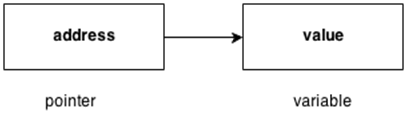
C++ Pointers
The pointer in C++ language is a variable, it is also known as locator or indicator that points to an address of a value.

Slide 12
Advantage of pointer
Pointer reduces the code and improves the performance, it is used to retrieving strings, trees etc. and used with arrays, structures and functions.
We can return multiple values from function using pointer.
It makes you able to access any memory location in the computer's memory.

Slide 13
Usage of pointer
Dynamic memory allocation
In c language, we can dynamically allocate memory using malloc() and calloc() functions where pointer is used.
Arrays, Functions and Structures
Pointers in c language are widely used in arrays, functions and structures. It reduces the code and improves the performance.

Slide 14
Symbols used in pointer
Symbol | Name | Description
& (ampersand sign) | Address operator | Determine the address of a variable.
∗ (asterisk sign) | Indirection operator | Access the value of an address.

Slide 15
Declaring a pointer
The pointer in C++ language can be declared using ∗ (asterisk symbol).
int ∗ a; //pointer to int
char ∗ c; //pointer to char

Slide 16
Pointer Example
#include<iostream>
using namespace std;
int main()
{
int number = 30;
int* p;
p = &number;
cout <<"Address of the number is: " << &number <<endl;
cout <<"Address of p variable is: " << p <<endl;
cout <<"Address of p variable is: "<<*p<<endl;
return 0;
}

Slide 17
Swap 2 numbers without using 3rd variable
#include<iostream>
using namespace std;
int main()
{
int a = 20, b = 10, *p1 = &a, *p2 = &b;
cout<<"Before swap: *p1 = "<<*p1<<" *p2 = "<<*p2<<endl;
*p1 = *p1 + *p2;
*p2 = *p1 - *p2;
*p1 = *p1 - *p2;
cout<<"After swap: *p1 = "<<*p1<<" *p2 = "<<*p2<<endl;
return 0;
}

